Slide 1

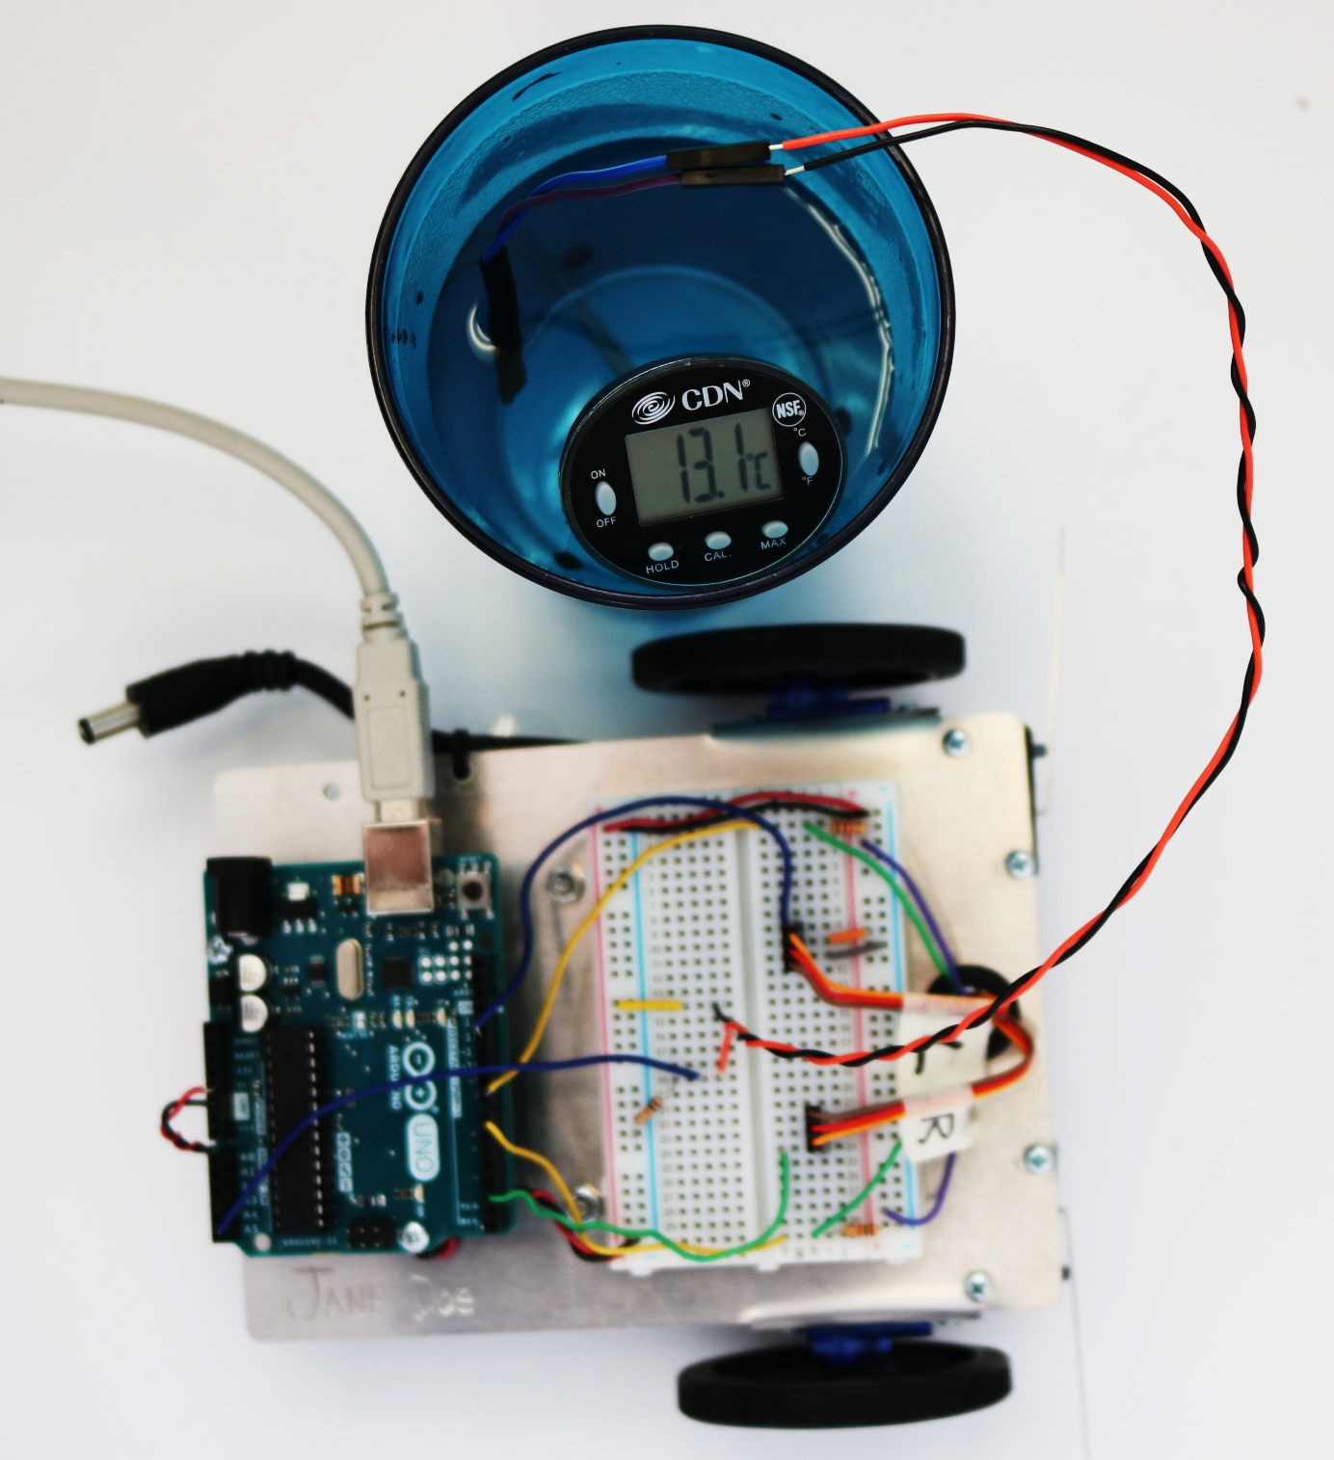
Thermistor Calibration

Slide 2


DISCLAIMER & USAGE
The content of this presentation is for informational purposes only and is intended for students attending Louisiana Tech University only.
The authors of this information do not make any claims as to the validity or accuracy of the information or methods presented.
Any procedures demonstrated here are potentially dangerous and could result in damage and injury.
Louisiana Tech University, its officers, employees, agents and volunteers, are not liable or responsible for any injuries, illness, damage or losses which may result from your using the materials or ideas, or from your performing the experiments or procedures depicted in this presentation.
The Living with the Lab logos should remain attached to each slide, and the work should be attributed to Louisiana Tech University.
If you do not agree, then please do not view this content.
boosting application-focused learning through student ownership of learning platforms

Slide 3
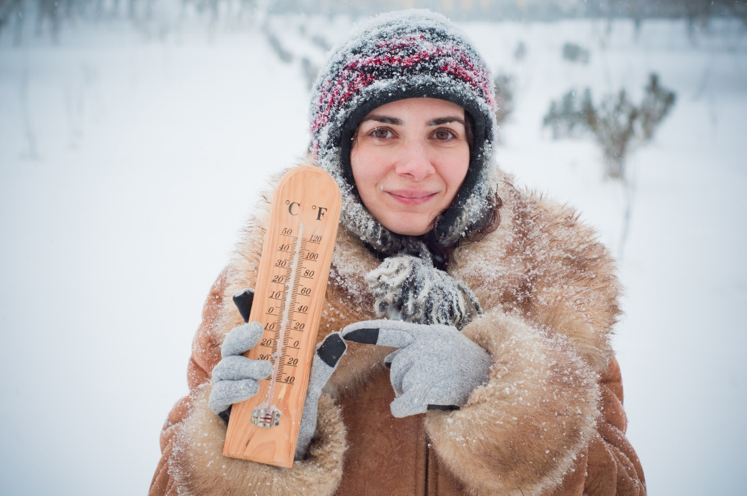
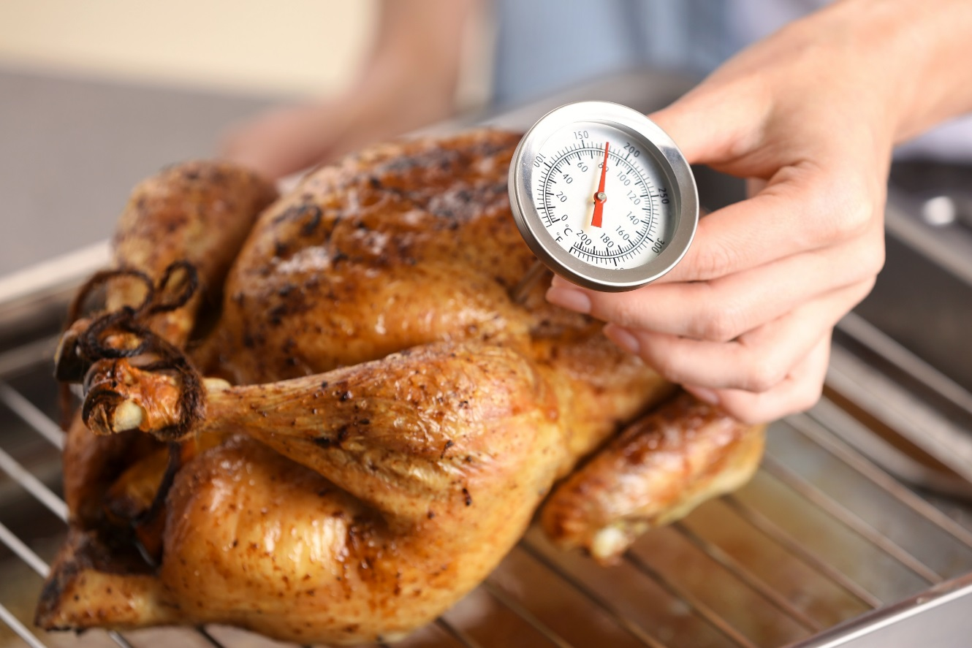
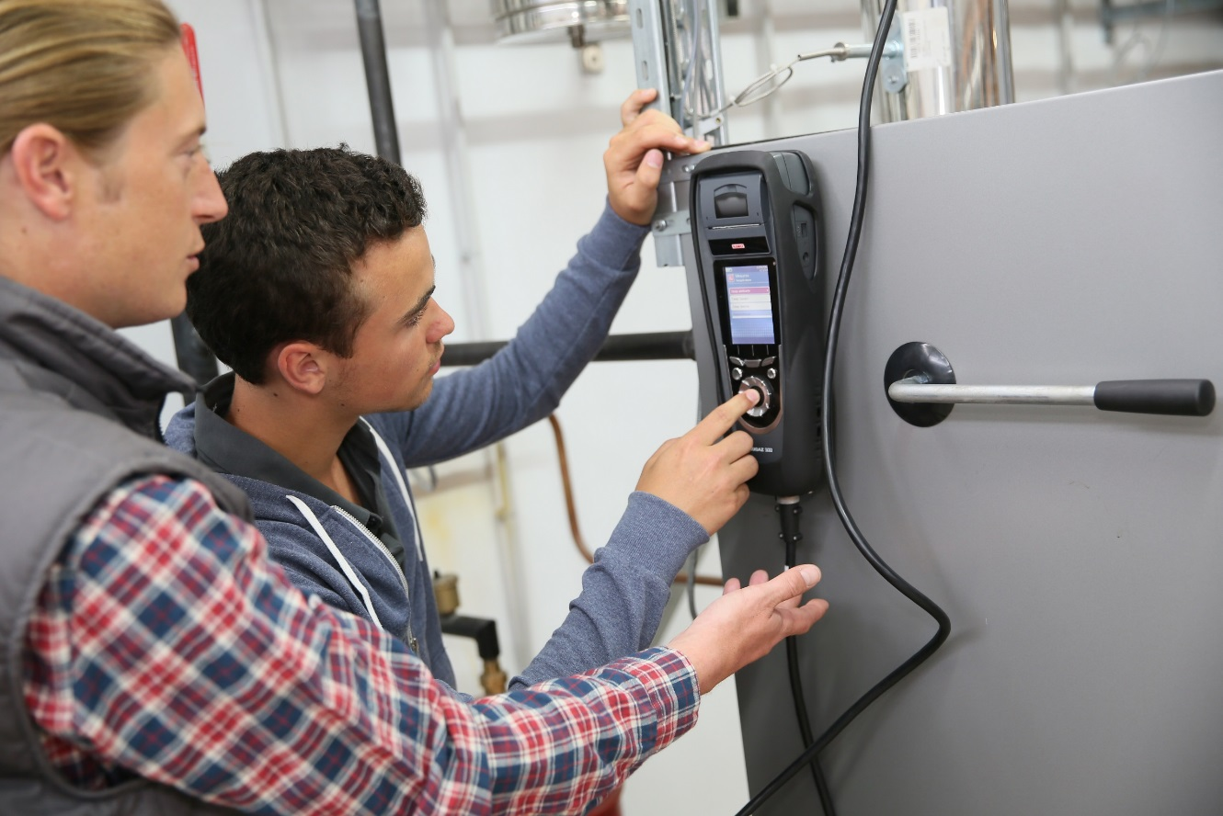
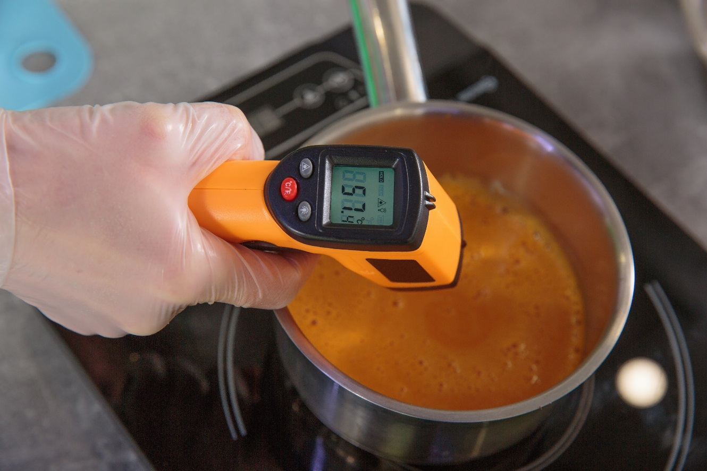
What is a temperature?
Sense of warmness of coldness of a material
Measure of the average thermal energy of particles in a material
Thermodynamic property of a substance that is related to the average energy of microscopic motions in a substance.

Slide 4
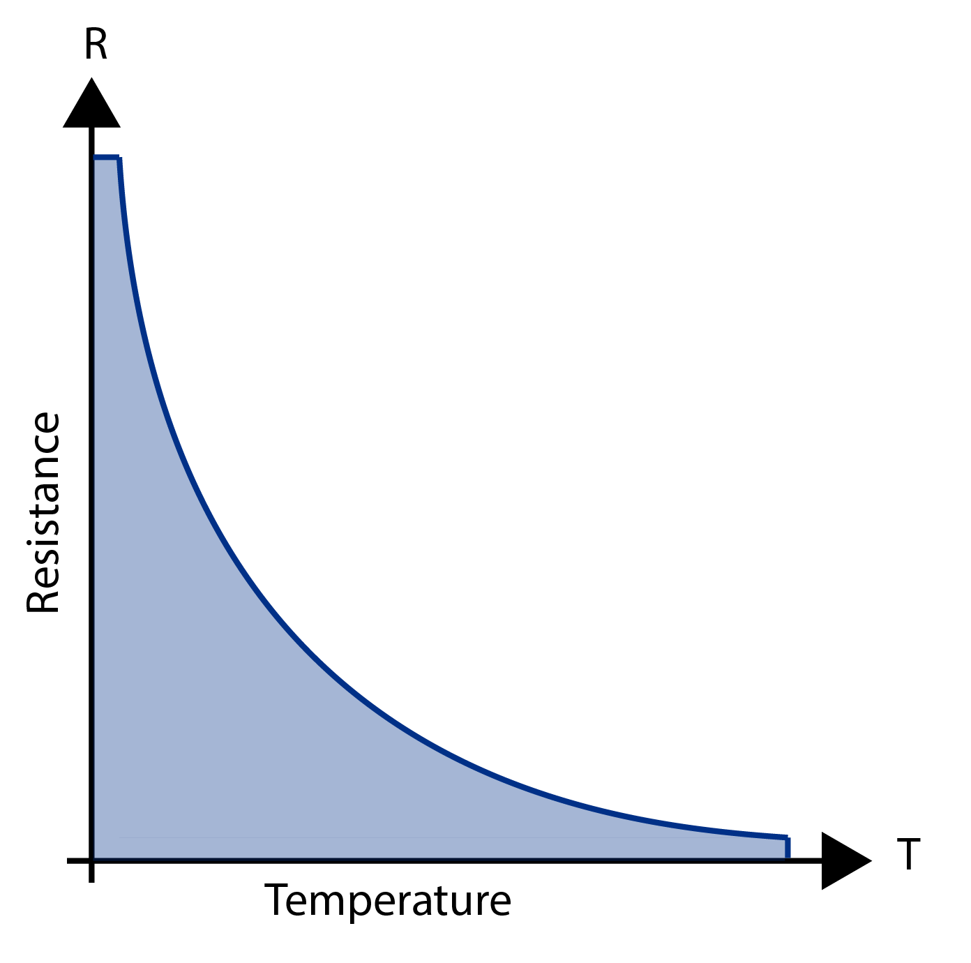
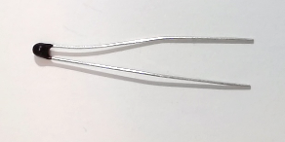
Measuring Temperature with a Thermistor
Measures electrical resistance changes with temperature
As resistance decreases, temperature increases
Advantages
High Output
Fast
Two-wire Ohm Measurement
Disadvantages
Non-linear
Limited Temperature Range
Fragile
Current Source Required
Self-heating
Circuit Diagram Symbol:

Slide 5
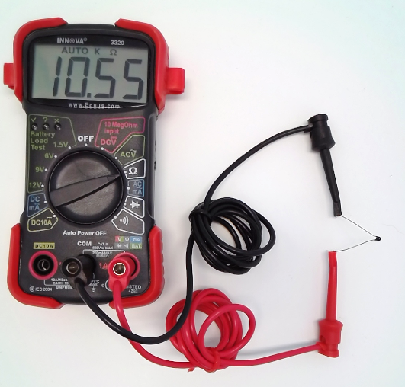
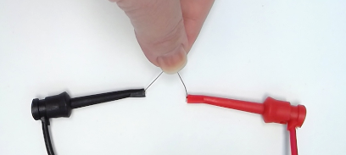
Measure Thermistor Resistance
Connect a thermistor to your multimeter
Measure its resistance
Hold the thermistor to change the temperature
Measure its resistance
What do you observe?
Resistance Decreases as Temperature Increases

Slide 6
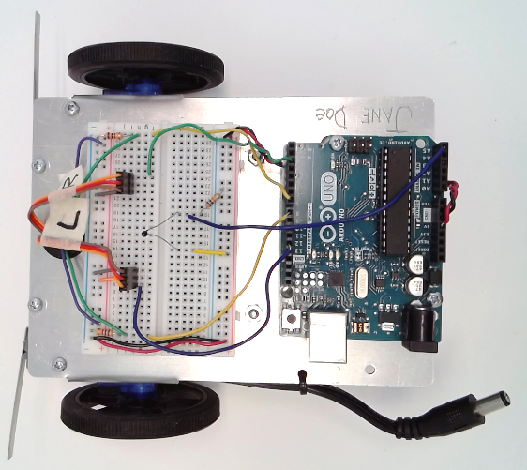
Collect Data Using Arduino
Connect the thermistor to your breadboard and Arduino
Use the given sketch to print analog values read by the voltage divider circuit
5V
int val = 0;
void setup() {
Serial.begin(9600);
}
void loop() {
val = analogRead(5);
Serial.println(val);
}
thermistor
analog input 5
10kΩ
Press your fingers over the thermistor (Increase temperature).
What do you observe?
Analog Value Increases as Temperature Increases

Slide 7
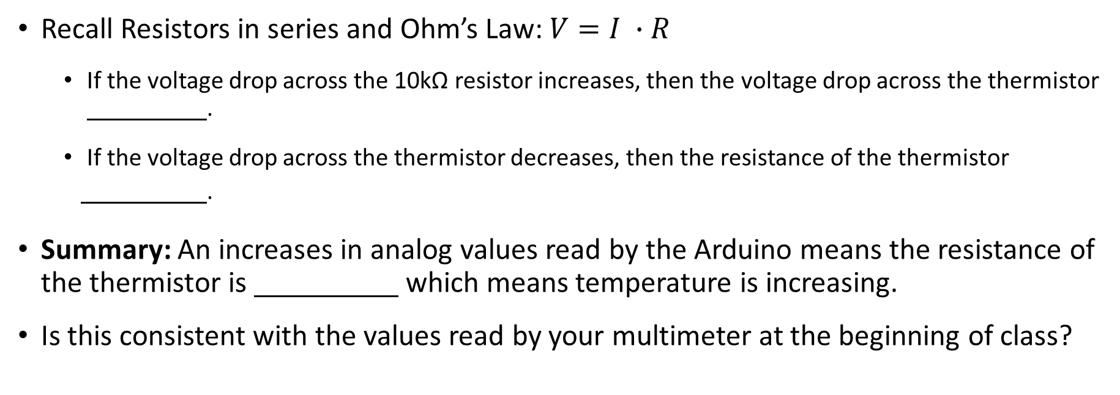
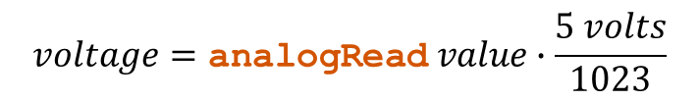
Collect Data Using Arduino
5V
Analog values can be converted to voltage drop across the 10kΩ resistor
thermistor
$$voltage=\text{analogRead} value∙\frac{5 volts}{1023}$$
analog input 5
10kΩ
Recall Resistors in series and Ohm’s Law: $V=I ∙R$
If the voltage drop across the 10kΩ resistor increases, then the voltage drop across the thermistor .
If the voltage drop across the thermistor decreases, then the resistance of the thermistor
.
Summary: An increases in analog values read by the Arduino means the resistance of the thermistor is which means temperature is increasing.
Is this consistent with the values read by your multimeter at the beginning of class?
decreases
decreases
decreasing

Slide 8
Calibration Equation
Develop an equation that correlates analog values to temperature values
Use known temperature values that are mapped to analog values read by the Arduino
Setup per three students:
1 Cup
1 digital thermometer
Setup per Individual
Waterproofed thermistor in voltage divider circuit
Arduino, laptop, Excel
Procedure (Details on subsequent slides):
Step 1: Waterproof your thermistor.
Step 2: Fill your cup with one of the water temperatures (cold, warm, or hot).
Step 3: Write down the °C value of the water from the thermometer and its corresponding analog value from the serial monitor.
Step 4: Repeat steps 2 and 3 for the all water temperatures. You should have a total of three data points (a °C value and analog value for each cup).
Step 5: Record data points in Excel & plot the data points on a scatter plot.
Step 6: Add the appropriate trendline and obtain the corresponding equation.
This is an individual activity. Share the cups and thermometer but perform the calibration on your own.

Slide 9
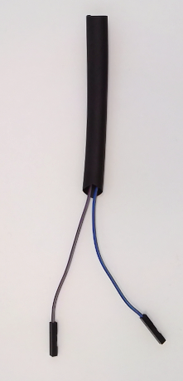
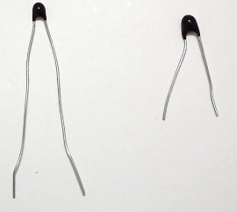
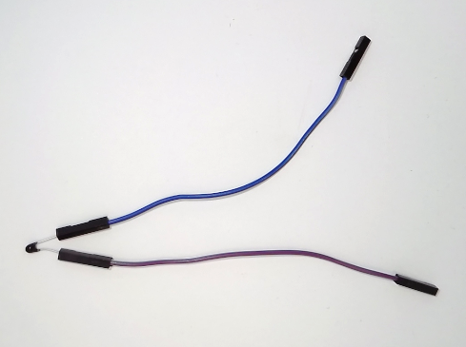
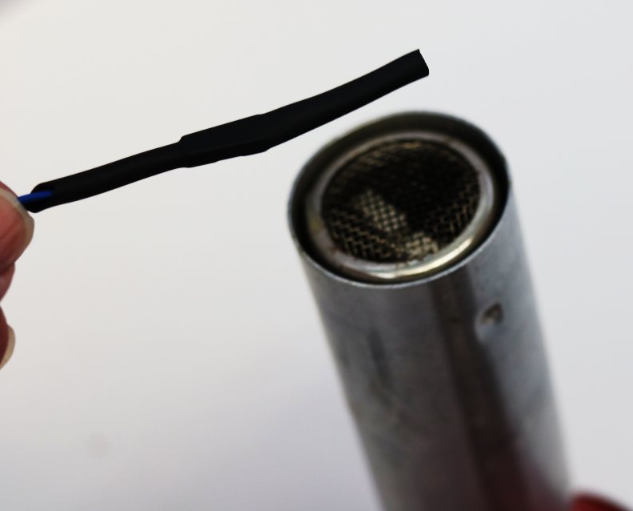
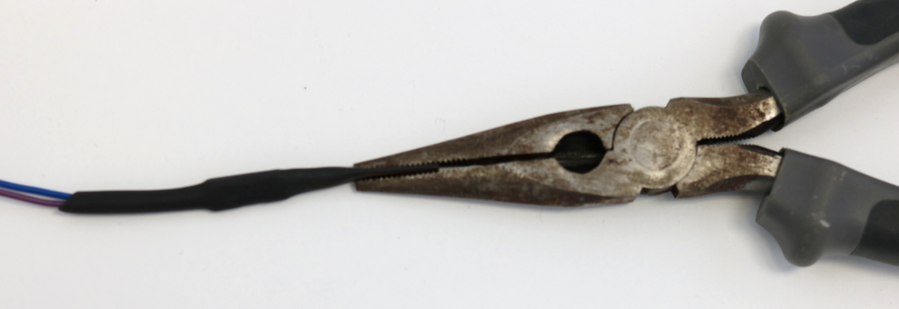
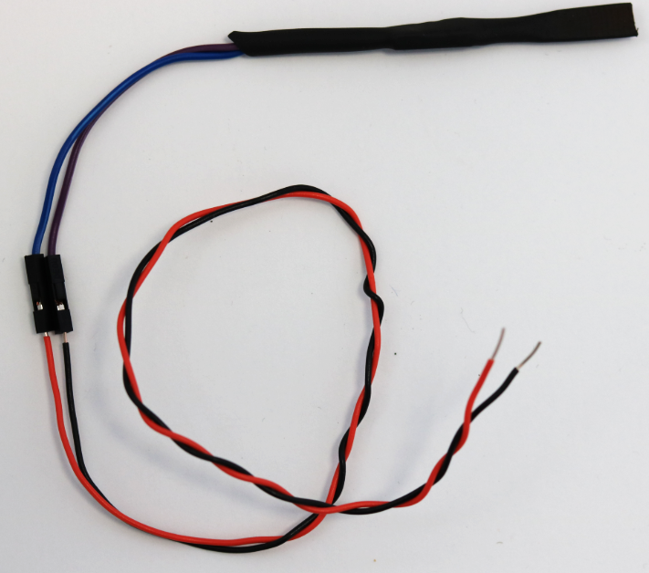
Step 1: Waterproofing Thermistor
1/2in of extra material
Note: Leave approx. 1/2in of material passed the thermistor to be used as for a seal
Tip of Thermistor here
Clip approx. 1/2in off of thermistor legs
Attach wire extensions to each leg
Cut heat shrink material to approx. 3in and slide it over the thermistor
Heat the end last so that it is amenable when clamping
Shrink material using heat gun
Clamp end of heated material to seal in the thermistor
Be sure to not crush the thermistor when clamping material
Strip wires jumper wires and connect them to wire extensions

Slide 10
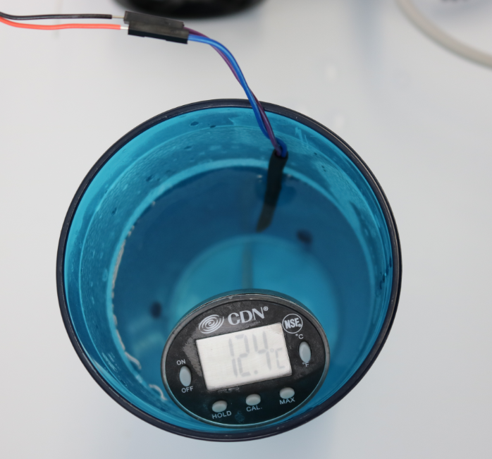
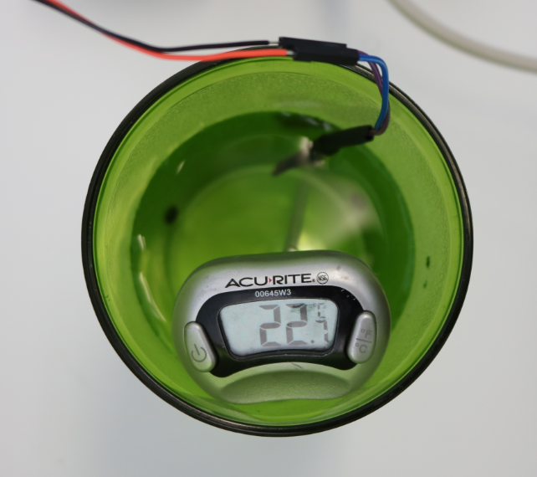
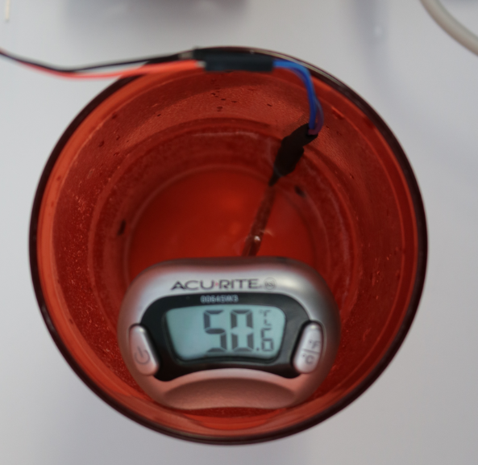
Step 2: Fill cup about 2/3 full with cool, warm, or hot water
Use sinks in the room to fill a cup with either cool water, warm water and hot water.
Step 3: Collect °C and analog values for each cup of water
Insert thermometer and thermistor into water while running the sketch that prints analogRead values.
Wait until values from thermistor circuit reach a steady value.
Record the temperature from the thermometer and the analog value on the Serial Monitor.
Repeat for each cup of water (three data points, °C value and analog value for each cup).
Return cups and thermometers when everyone is finished collecting data.
cold
warm
hot
Step 4: Repeat Steps 2 & 3 for all water temperatures.

Slide 11
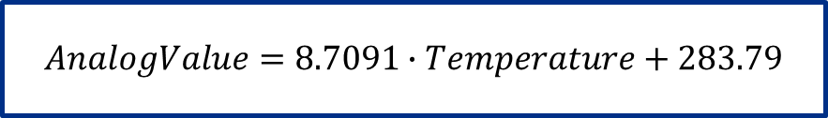
Step 5: Record data points in Excel and Plot data points Step 6: Add trendline and equation on chart
Temperature | Analog Value
ᵒC | 0 to 1023
12.2 | 384
22.1 | 484
57.4 | 782
use five digits for these fitting constants
Calibration Equation:
$$AnalogValue=8.7091∙Temperature+283.79$$

Slide 12

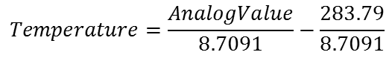
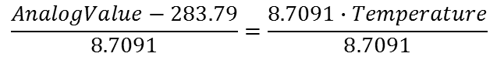
Using the Calibration Equation
When temperature is known, input temperature and get corresponding analog value
What if temperature is not known?
$$AnalogValue=8.7091∙Temperature+283.79$$
Invert Equation
Algebraically: Solve for Temperature
Graphically: Swap x and y axis
$$AnalogValue=8.7091∙Temperature+283.79$$
$$AnalogValue−283.79=8.7091∙Temperature+283.79−283.79$$
$$\frac{AnalogValue−283.79}{8.7091}=\frac{8.7091∙Temperature}{8.7091}$$
$$Temperature=\frac{AnalogValue}{8.7091}−\frac{283.79}{8.7091}$$
$$Temperature=0.1148∙AnalogValue−32.585$$
$$Temperature=0.1147∙AnalogValue−32.512$$
Small but negligible difference in equations depending on method used

Slide 13
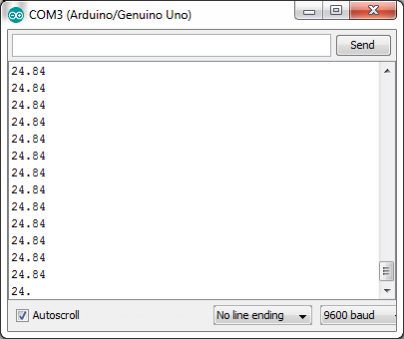
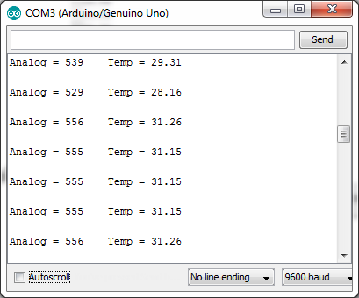
Using the Calibration Equation
Adapt the Arduino sketch to print the values of temperature
Use Excel or your calculator to check the equation
Tip: Set the analog value to be a constant while checking
What happens when you declare the temperature variable to be a float instead of an int
float is a data type that allows for decimal values
Adapt the sketch to print both the analog value and its corresponding temperature value as a decimal

